Slide 1
Optical flow switching

Slide 2
Optical flow switching
Electro-optical bottleneck
  Unlike individual wavelength switching (IWS) & synchronous optical packet switching (OPS), electronic IP packet switching networks provide several benefits
    Network-wide synchronization is not required
    Support of variable-size IP packets
    Simpler & more efficient contention resolution by using electronic random access memory (RAM)
  However, due to steadily growing line rates & amount of traffic electronic routers may become bottleneck in high-speed optical networks => electro-optical bottleneck

Slide 3
Optical flow switching
OFS
  One of the main bottlenecks in today’s Internet is (electronic) routing at IP layer
  Methods to alleviate routing bottleneck
    Switching long-duration flows at lower layers (e.g., GMPLS) => routers are offloaded & electro-optical bottleneck is alleviated
  Concept of lower-layer switching can be extended to switching large transactions and/or long-duration flows at optical layer => optical flow switching (OFS)
  Definition of flow
    Unidirectional sequence of IP packets between given pair of source & destination IP routers
    Both source & destination IP addresses, possibly together with additional IP header information such as port numbers and/or type of service (ToS), used to identify flow

Slide 4
Optical flow switching
OFS
  In OFS, a lightpath is established for the transfer of large data files or long-duration & high-bandwidth streams
  Forms of OFS
    Use of entire wavelength for a single transaction
    Flows with similar characteristics may be aggregated & switched together by means of grooming in order to improve lightpath utilization
  Issues of OFS
    How to recognize start & end of flows
    Size of flow should be in the order of the product of round-trip propagation delay & line rate of set-up lightpath

Slide 5
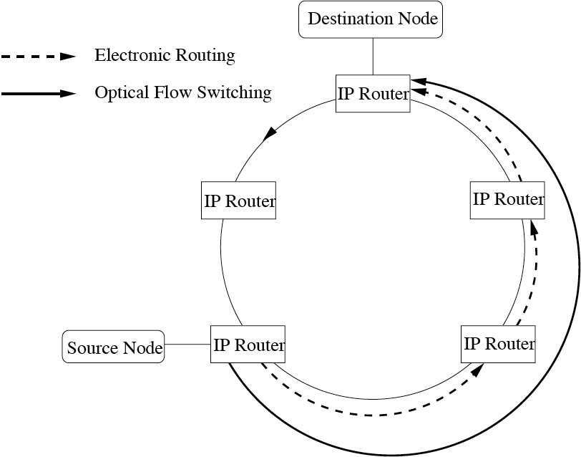
Optical flow switching
OFS vs. electronic routing
  In OFS, data is routed all-optically in order to bypass & offload routers
  Set-up lightpath eliminates need for packet buffering & processing at inter- mediate routers
  OFS can be
    End-user initiated
    IP-router initiated

Slide 6
Optical flow switching
Advantages
  Mitigation of electro-optical bottleneck by optically bypassing & thus offloading electronic IP routers
  OFS represents highest-grade QoS
    Established lightpath provides dedicated connection not impaired by presence of other users
Issues
  Set-up of lightpaths must be carefully determined since wavelengths are typically a scarce resource
  Without use of wavelength converters, wavelength continuity constraint further restricts number of available wavelengths

Slide 7
Optical flow switching
Integrated OFS approaches
  Dynamic lightpath set-up in OFS networks involves three steps
    Routing
    Wavelength assignment
    Signaling
  Integrated OFS approaches for end-user initiated lightpath set-up
    Tell-and-go (TG) reservation
    Reverse reservation (RR)

Slide 8
Optical flow switching
Tell-and-go (TG) reservation
  Distributed algorithm with no wavelength conversion based on link state updates
  Updates processed at each network node to acquire & maintain global network state
  Given the network state, TG uses combined routing & wavelength assignment strategy
    K shortest path routing with first-fit wavelength assignment
    Optical flow is dropped if no route with available wavelength can be found
  Connection set-up achieved using tell-and-go signaling
    One-way reservation
    Control packet precedes optical flow along chosen route in order to establish lightpath for trailing optical flow
    Control packet & optical flow are terminated if not sufficient resources available at any intermediate node

Slide 9
Optical flow switching
Reverse reservation (RR)
  Unlike TG, RR does not require (periodic or event-driven) updates to acquire & maintain global network state
  Initiator of optical flow sends information-gathering packets, so-called info-packets, to destination node on K shortest paths
  Info-packets record link state information at each hop
  After receiving all K info-packets, destination node performs routing & first-fit wavelength assignment
  Connection established via reverse reservation
    Destination node sends reservation control packet along chosen route in reverse
    Control packet configures intermediate switches & finally informs initiator about lightpath set-up
    Otherwise, reservation is terminated & all resources held by reservation are released by sending additional control packets if control packet does not find sufficient resources

Slide 10
Optical flow switching
Implementation
  OFS experimentally investigated in Next Generation Internet Optical Network for Regional Access using Multiwavelength Protocols (NGI ONRAMP) testbed
    Bidirectional feeder WDM ring (8 wavelengths in each direction) connecting 10-20 access nodes (ANs) & backbone network
    ANs serve as gateways to attached distribution networks of variable topologies, each accommodating 20-100 users
    AN
      Consists of IP router & ROADM
      Routes optical wavelength channels & IP packets inside wavelength channels between feeder ring, IP router, and distribution network
    Services
      IP service
        Involves electronic routing
      Optical service
        OFS with all-optical end-to-end connection

Slide 11
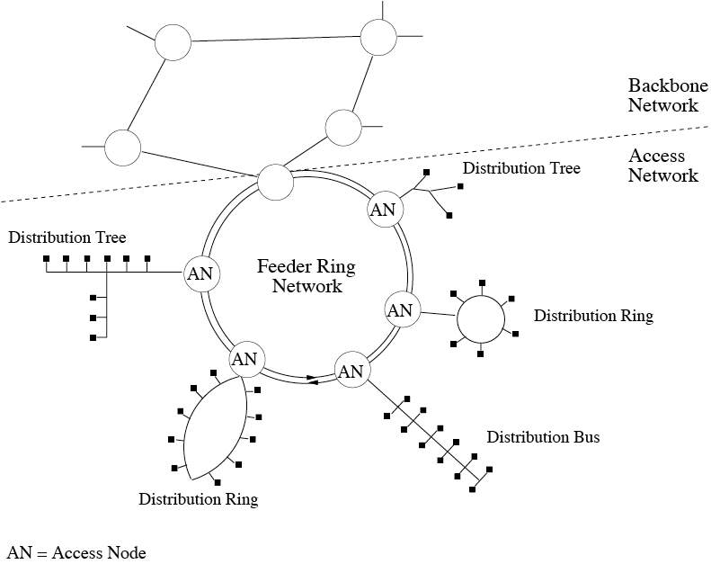
Optical flow switching
NGI ONRAMP

Slide 12
Optical flow switching
Flow detection
  Flow detection that triggers the dynamic set-up of lightpaths is critical in OFS networks
  Example of flow detection
    x/y classifier
      x denotes number of passing packets belonging to a given flow
      y denotes prespecified period of time
      Depending on whether value of classifier is above or below predefined threshold, flow is considered active or inactive, respectively
      Node detects beginning of flow if value exceeds threshold
      Node assumes end of flow if value falls below threshold

Slide 13
Optical flow switching
Comparison between OFS & OBS
  OFS
    Detection of flow start
      For each arriving packet ingress router checks if there is existing flow
        If so, packet is sent immediately over lightpath or is buffered if lightpath is currently set up
        If not, packet is considered first packet of new flow & is buffered, followed by lightpath set-up
    Lightpath set-up
      Upon flow detection, lightpath request is sent to egress router
      Buffered packets of flow are discarded when NAK arrives at ingress router
      Buffered packets of flow are sent after receiving ACK

Slide 14
Optical flow switching
Comparison between OFS & OBS
  OFS
    Detection of flow end
      Ingress router considers that a flow ends if there is no packet going to the respective egress node within a period called maximum interpacket separation (MIS)
    Lightpath release
      As soon as flow ends & last packet of flow is sent, ingress node sends lightpath release request to egress node to tear down lightpath
    Impact of parameter MIS on performance
      Smaller MIS value
        Results in shorter flows => more frequent lightpath set-ups/releases & increased signaling overhead
      Larger MIS value
        Results in longer idle gaps between packets in a flow => decreased lightpath utilization

Slide 15
Optical flow switching
Comparison between OFS & OBS
  OBS
    OFS suffers from two major drawbacks
      Two-way reservation => lightpath set-up delay of one RTT
      Dedicated lightpath => no statistical multiplexing
    Optical burst switching (OBS) avoids shortcomings of OFS at expense of guaranteed QoS
      OBS relies on one-way reservation
      OBS allows for statistical sharing of wavelength channel among burst belonging to different flows

Slide 16
Optical flow switching
Comparison between OFS & OBS
  OBS
    Operation of OBS
      Each ingress router assembles incoming IP packets going to same egress router into burst according to some burst assembly schemes
      For each burst, a control packet is first sent out on control wavelength channel to egress router, followed by burst on a separate data wavelength channel after prespecified offset time
      Control packet goes through OEO conversion at every intermediate node & attempts to reserve data wavelength channel for just enough time to accommodate following burst on outgoing link
      Egress router disassembles burst into individual IP packets

Slide 17
Optical flow switching
Comparison between OFS & OBS
  OBS
    Burst assembly scheme
      Several possibilities exist to assemble bursts
      Example
        Packets going to same egress router that arrived during fixed period of time, called burst assembly time (BAT), are assembled into single burst
        Packets arriving after next assembly cycle begins will be assembled into different burst
      Impact of parameter BAT on performance
        Smaller BAT value => shorter bursts & more control packets
        Larger BAT value => longer end-to-end delay due to increased assembly delay
      BAT burst assembly scheme guarantees bounded assembly delay, but not necessarily guaranteed burst delivery due to possible collisions at intermediate nodes

Slide 18
Optical flow switching
Comparison between OFS & OBS
  Results
    10-node mesh WDM network
    Up to 100 wavelength channels per link & wavelength conversion at each node
    OBS outperforms OFS in terms of percentage of dropped packets & mean end-to-end delay for wide range of used wavelength channels & traffic loads
    OFS can achieve smaller mean end-to-end delay than OBS by using sufficiently large MIS value
    Parameter BAT does not have significant impact on mean end-to-end delay since BAT is several orders of magnitude smaller than one-way propagation delay

